Slide 1
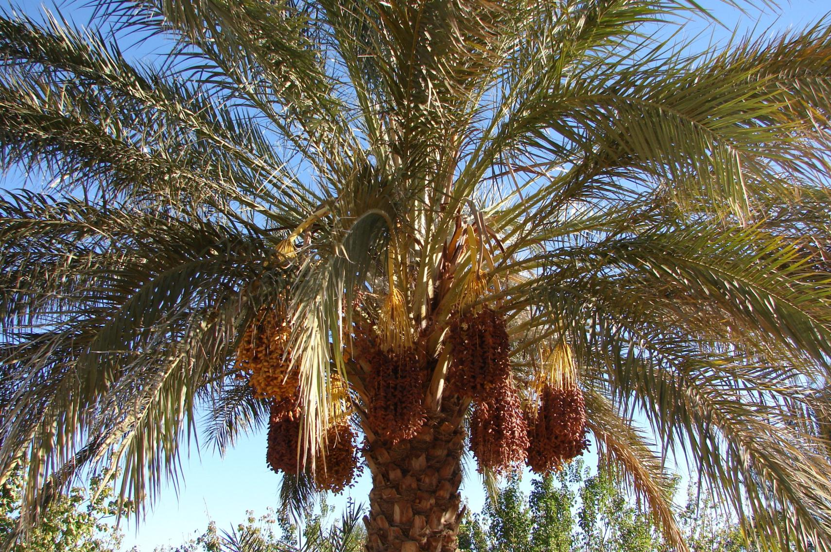


ARECACEAE
PRINCIPES
Architecture
Model
Hervé Rey, René Lecoustre, Sébastien Griffon, 2014

Slide 2
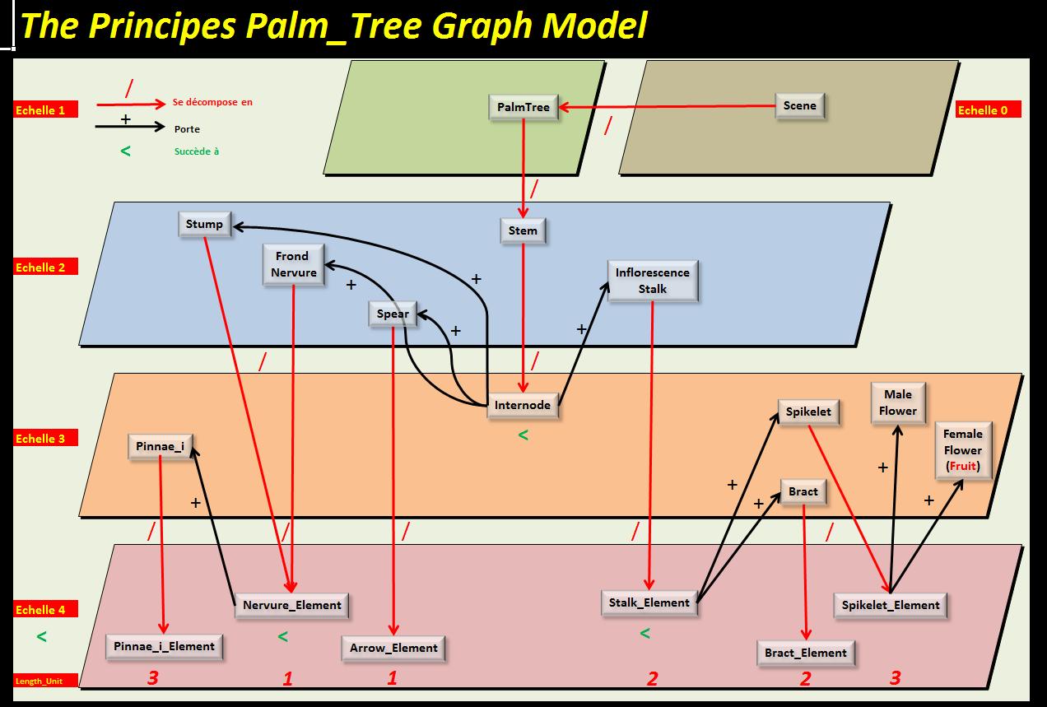
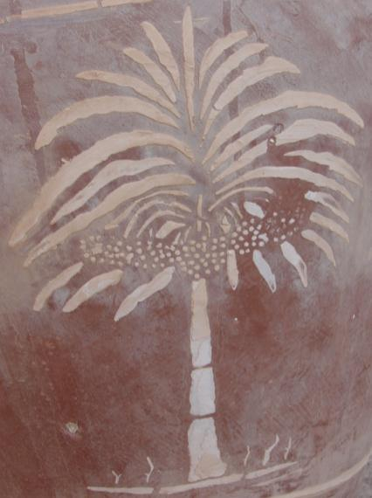
?

Slide 3
Why
« Principes »
?
3

Slide 4
Palm Trees :
Carl Linnaeus (1707-1778) named them
« PRINCIPES »
« Princes » of vegetal world,
Thanks to their royal look.
4

Slide 5
Caracteristics | Date Palm | Oil Palm | Coconut Palm
Tree Number in world | 180 10⁶ | 1 250 10⁶
Production Fruit (T) in world | 6.7 10⁶ | 10⁶
Production Oil (T) In world |  | 33 10⁶ | 3.2 10⁶
Planted Area (Ha) In world | 1.8 10⁶ | 9.2 10⁶ | 9.4 10⁶
Av. Tree nb / Ha | 100 | 136 | 130
Av. fruit Yield (Kg/Tree/year) | 40 (40–400) | 132 (100-200)
Av fruit Yield (T/Ha) | 4 (4-40) | 18 (15-30) | 0.3 - 0.5
Av. Oil Yield (Kg/Tree) |  | 26 (20-40)
Av. Oil Yield (T/Ha) |  | 3.5 (3-10) | 0.3 – 0.5
Extraction rate Oil / Fruit (%) |  | 20 (20-35) | 60-70 (coprah)
5

Slide 6
What
Is
Principes
?
6

Slide 7
Principes is a model
For palm-trees
(principes)
For Architecture
(structural)
Growth
(organs)
& development
(without functioning)
7

Slide 8
Principes is featured
As Individual based model
At organ Scale
For plant & plot reconstructions
8

Slide 9
Principes is based on
Inputs
(Parameter values)
a formalism
(Mtg)
A growth engine
(Implemented in xplo)
OutpUts
(3D mockups)
9

Slide 10
Principes takes as input
Parameter values
Coming from organ’s
observations
Indexed & Expressed
through piecewise functions
according to their characteristics
10

Slide 11
Principes is formalized
Through a
Multi-scale tree graph model (MTG)
With
Vertices
For organs
Edges
For topology
Attributes
For parameters values
11

Slide 12


Principes is implemented
In AMAPSTUDIO Suite
& benefits of its features
Project manager
Browser & 3D view
Extraction functions
Script mode
Plots
12

Slide 13
Principes computes outputs
3D mockups
With
Structure (navigation)
Topological characteristics
Attributes
3D MOCKUPS
can be used
For any
Further application
13

Slide 14
Such as
Knowledge
Analysis (breeding)
Simulation & Exploration
Radiative balance
Carbon Balance
…
14

Slide 15
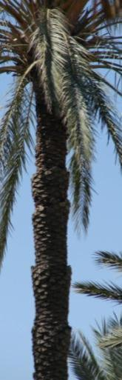
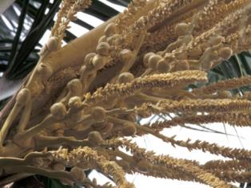
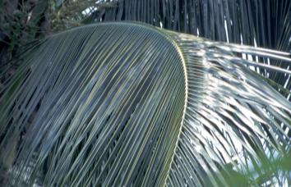
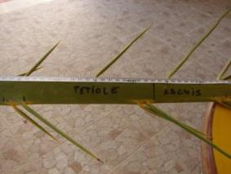
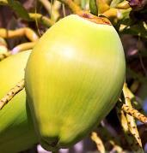
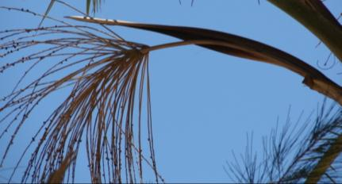
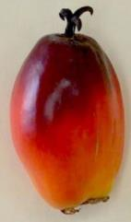
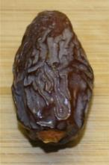
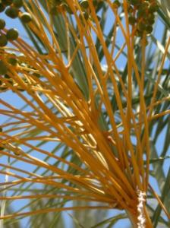
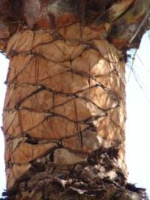
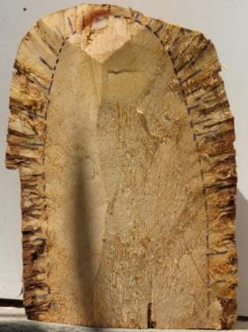
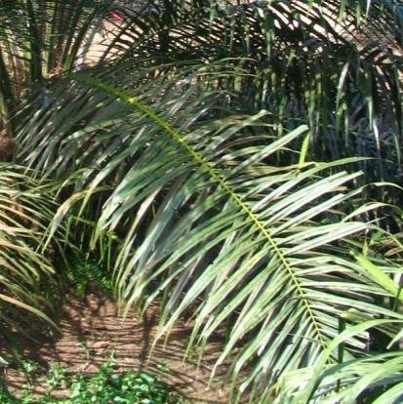
Organs
&
typology
15

Slide 16
TYPOLOGY
« organ »
or
« vertex »
« vertices»

Slide 17
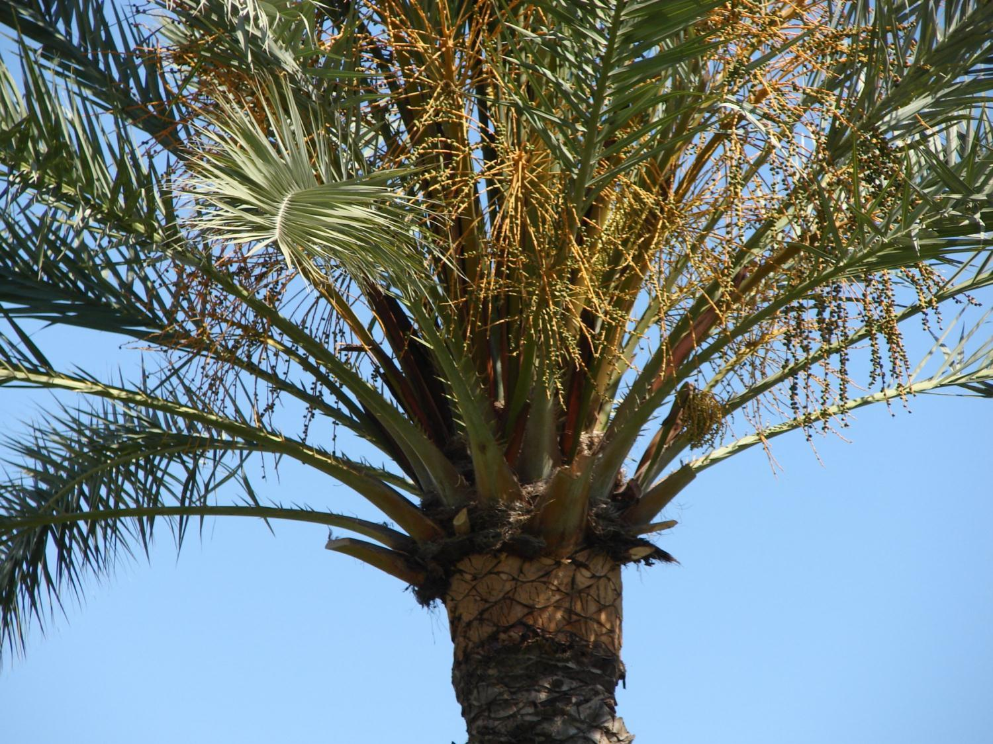
Frond
Frond Nervure
Rachis
Leaflets
Pinnae_2
Spines
Pinnae_1
Petiol
Stem
Stump
Phoenix dactylifera

Slide 18
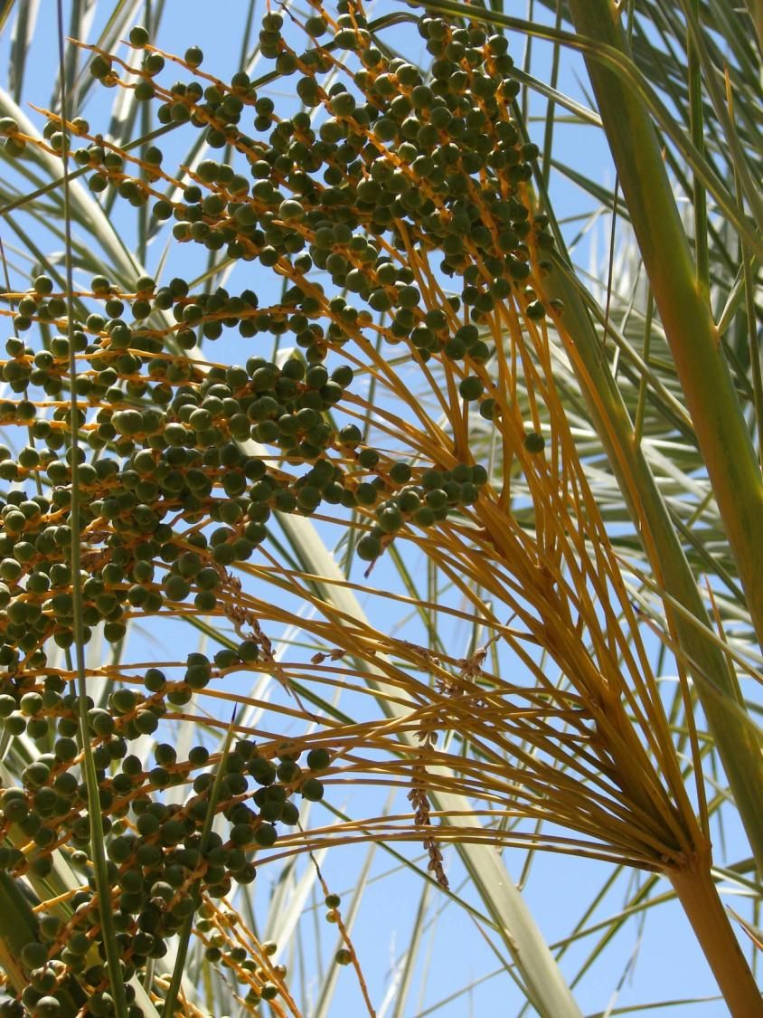
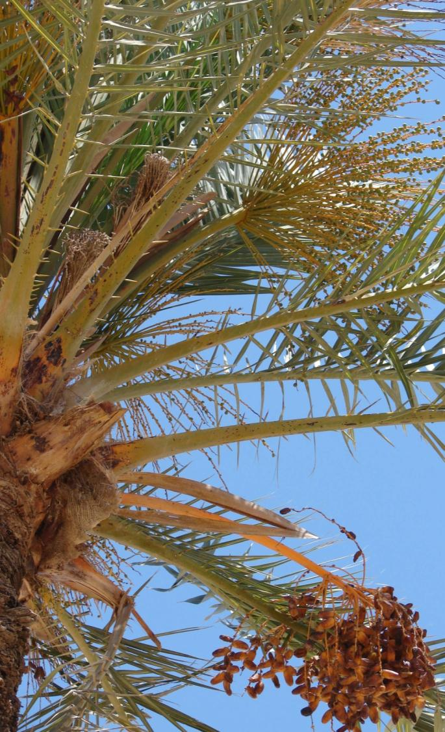
Inflorescences
Date
rachis
Spikelet
Bract
Stalk
Steril zone
Fertil zone
Peduncle
Phoenix dactylifera
18

Slide 19
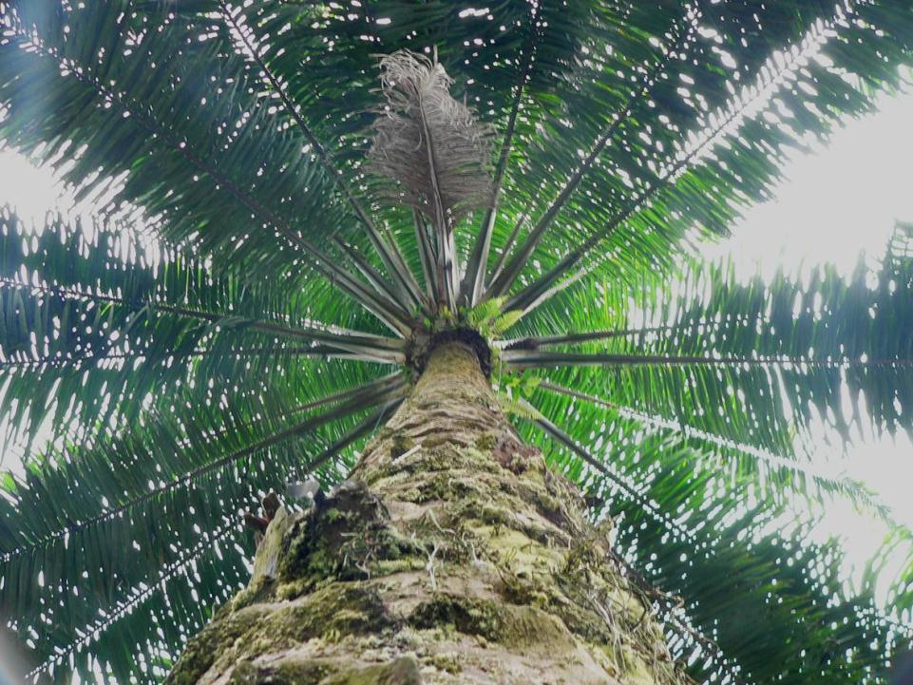
Rachis
Frond
Petiol
Frond Nervure
Leaflets
Pinnae_2
Thorns
Stump
Stem (Stipe)
Elaeis guineensis

Slide 20
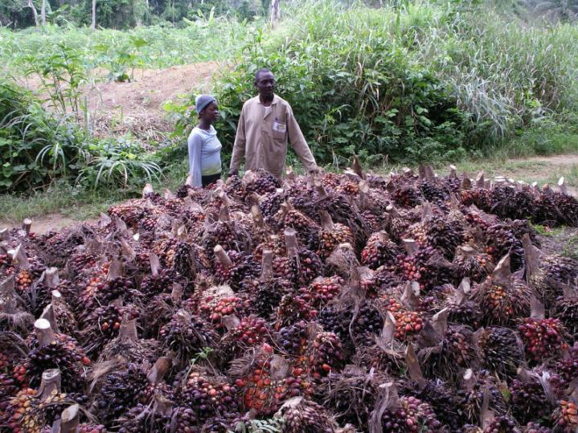
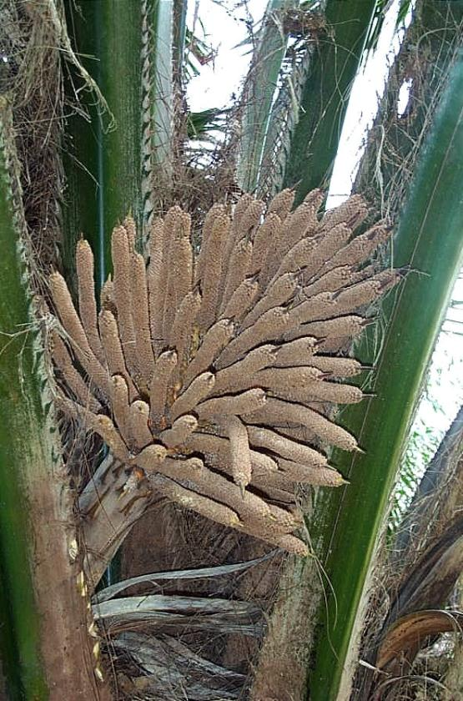
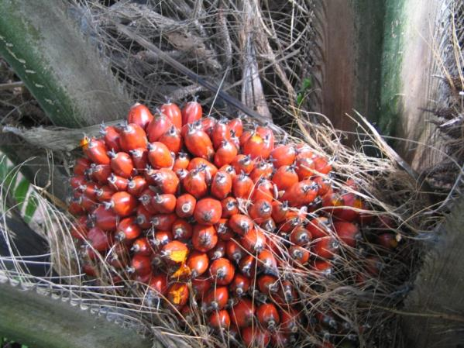
Male or Female
Inflorescences
On same Tree
Bunches
Spikelets
Stalk
Fruits
Peduncle
Male Inflorescence
Elaeis guineensis
Female Inflorescence
20

Slide 21

Leaflets
Pinnae_2
Frond
Bract
Petiol
Frond Nervure
Rachis
Stem (Stipe)
Cocos nucifera

Slide 22
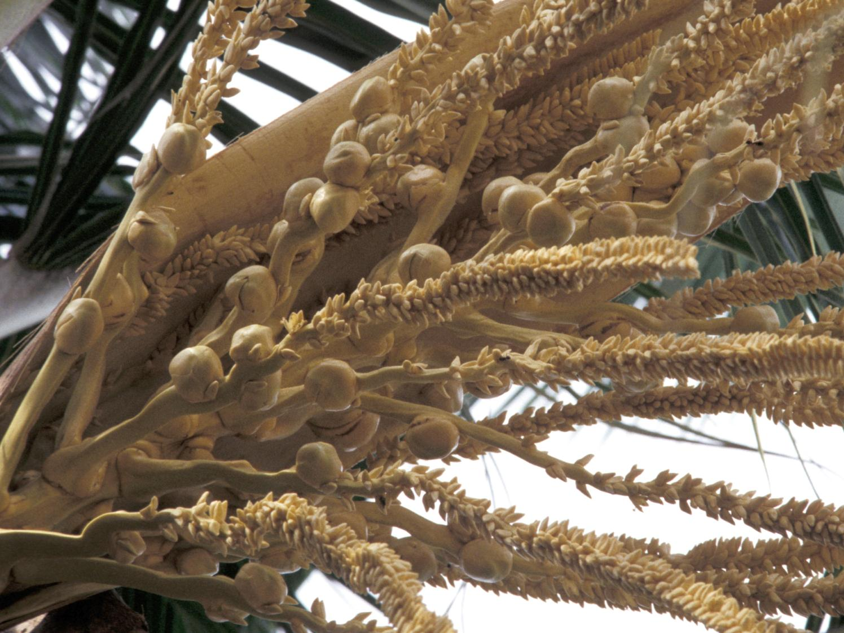
Male & Female Inflorescences
rachis
Bract (spathe for palms)
Coconut
Male Flowers
Stalk
Spikelet
Peduncle
Cocos nucifera
22

Slide 23
Scales

Slide 24
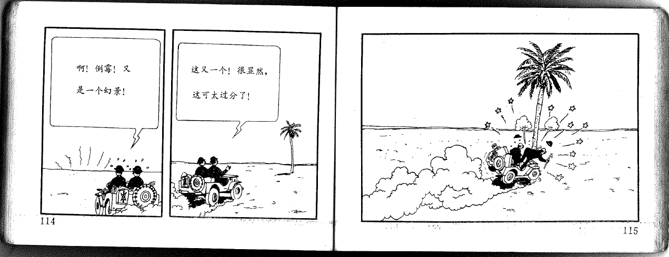
Scales
24

Slide 25
Scales
Scale relationship
Noted « / »
If « a » is composed of n entities « a_{i} »: (noted a / a_{i} )
« a » is the complex of « a_{i} »
« a_{i} » is a component of « a »

Slide 26
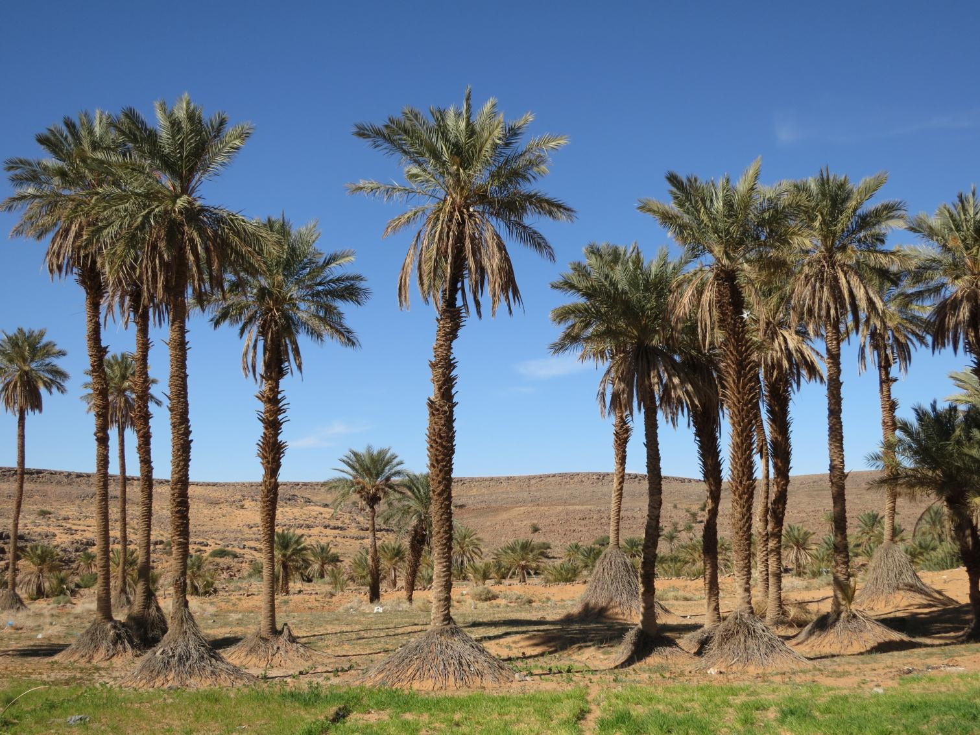
« Plot » is the complex of « Palm-trees »
« Palm-trees » are components of « Plot »
Scales
Zoom
Phoenix dactylifera

Slide 27
« Palm-Tree » is the complex of « Stem »
« Stem » is a component of « Palm-Tree »
Scales
Phoenix dactylifera

Slide 28
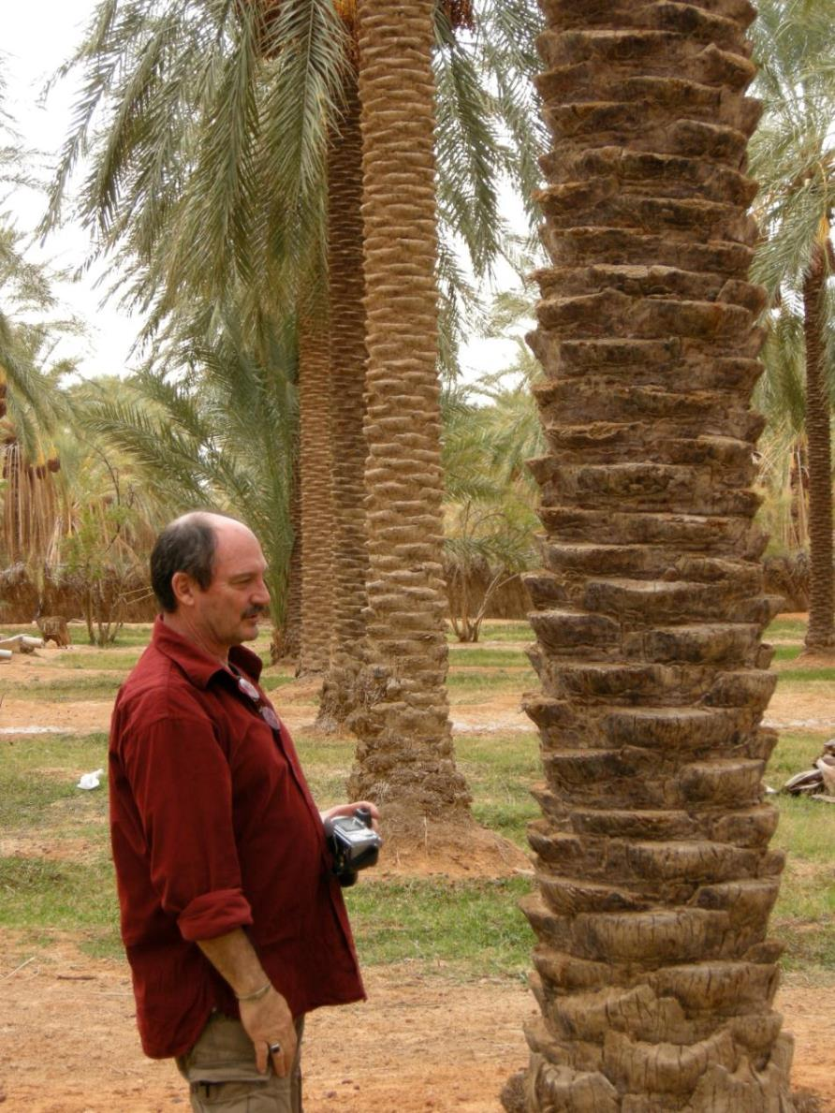
Scales
« Stem »
Is the complex of
«Internodes ».
« Internodes »
are components
of « Stem ».
Phoenix dactylifera
28

Slide 29
« Frond » is the complex of « Pinnae »
« Pinnae » are components of « Frond »
Scales
Phoenix dactylifera

Slide 30
Scales
Scale 1
/
Scale 2
/
Scale 3
/
Scale 4
Palm-Tree
Stem (stipe)
Spear
Frond
Nervure
Stump
Inflorescence
stalk
Internode
Pinnae
Bract
Spikelet
Flower
Fruit
Geometrical
Elements
(computer
Scale)
Miulti-scales description…>
30

Slide 31
Branching
Topology
Branching

Slide 32
Branching
Branching
(Ramification)
Noted « + »
If « a » bears « b » : (noted a + b)
« a » is the father of « b »
« b » is a son of « a »
* bitch

Slide 33
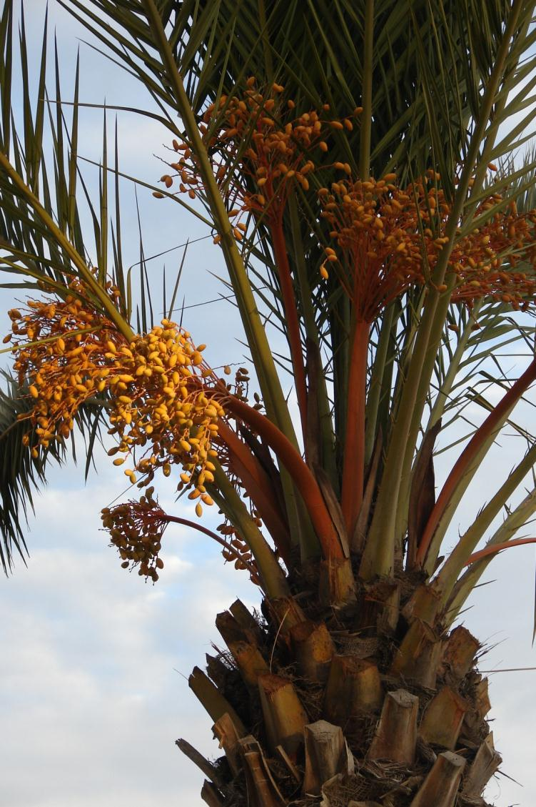
Branching
Stem bears :
Spears
Fronds
Inflorescences
Stumps
Phoenix dactylifera
33

Slide 34

Branching
Frond-Nervure bears pinnaes
Phoenix dactylifera

Slide 35
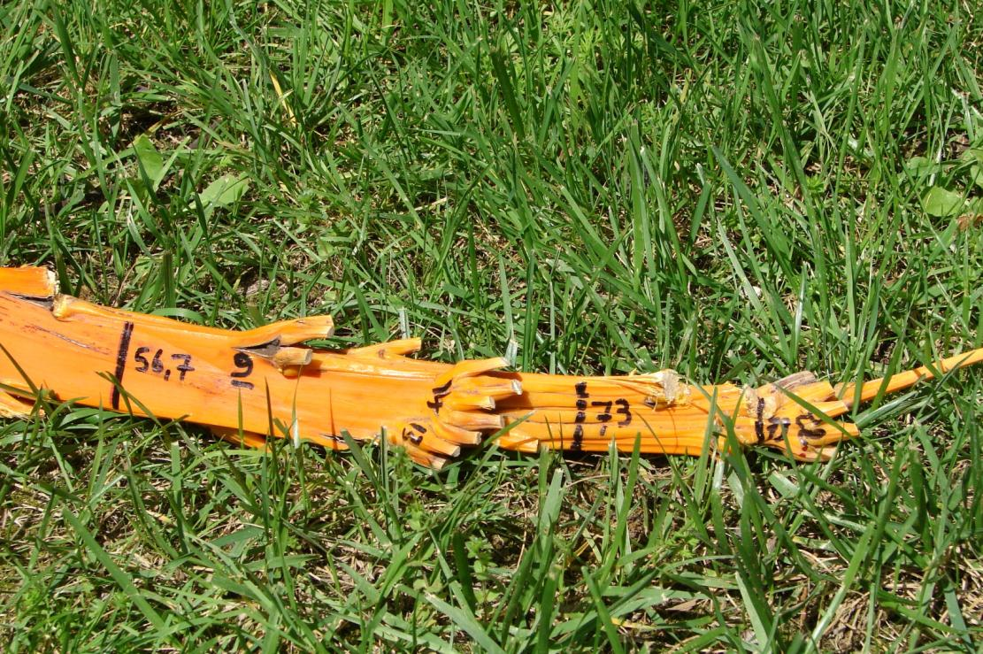
Branching
Stalk bears Spikelets
Spikelets bears
Flowers / Fruits
Phoenix dactylifera
35

Slide 36
Branching
Stem
Internodes
Frond
Nervure
Inflorescence
Stalk
Spikelet
+
+
+
+
Spears
Fronds
Stumps
Inflorescences
Offshots…
Pinnae
Bract
Spikelet
Flower
Fruit
Branching order…>
36

Slide 37
Succession
Topology
succession

Slide 38
Succession
Succession
Noted « < »
If « a » & « b » are on the same oriented axis
(meristem functioning) and a was made before b
« a » is the predecessor of « b » (noted a<b)
« b » is the successor » of « a »

Slide 39
Succession
Stem Internodes
Follow
Each other
Phoenix dactylifera
39

Slide 40
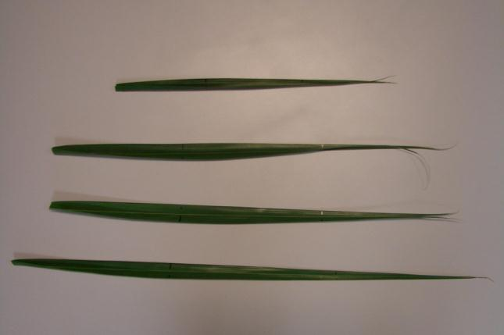
Succession
Pinnae Elements
Phoenix dactylifera

Slide 41
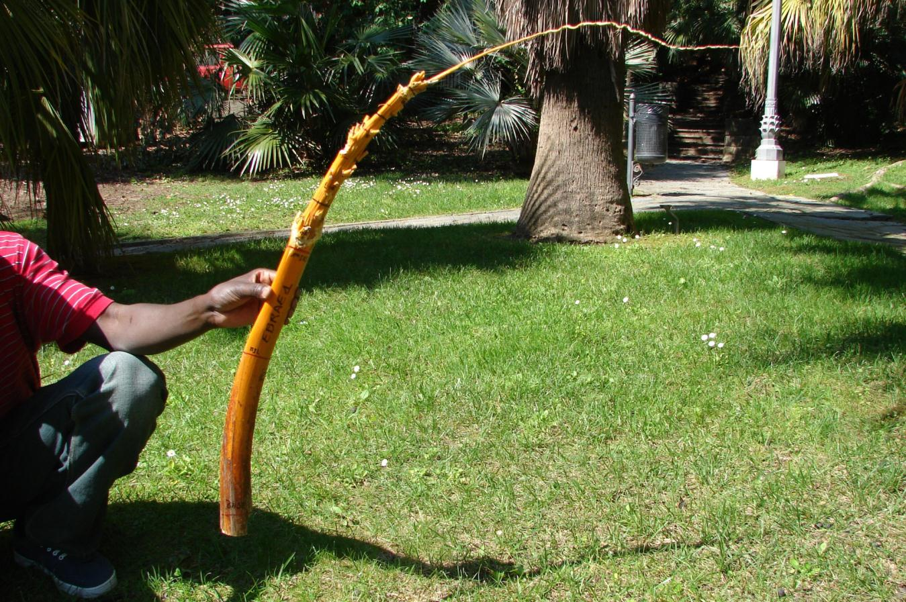
Succession
Phoenix dactylifera
Stalk Elements
41

Slide 42
Succession
Scale 1
/
Scale 2
/
Scale 3
/
Scale 4
Tree
Stem
Spear
Frond Nervure
Stump
Inflorescence Stalk
Internode
Pinnae
Bract
Spikelet
Flower
Fruit
Geometrical
Elements
Position in axis…>
42

Slide 43
PRINCIPES
MODEL

Slide 44
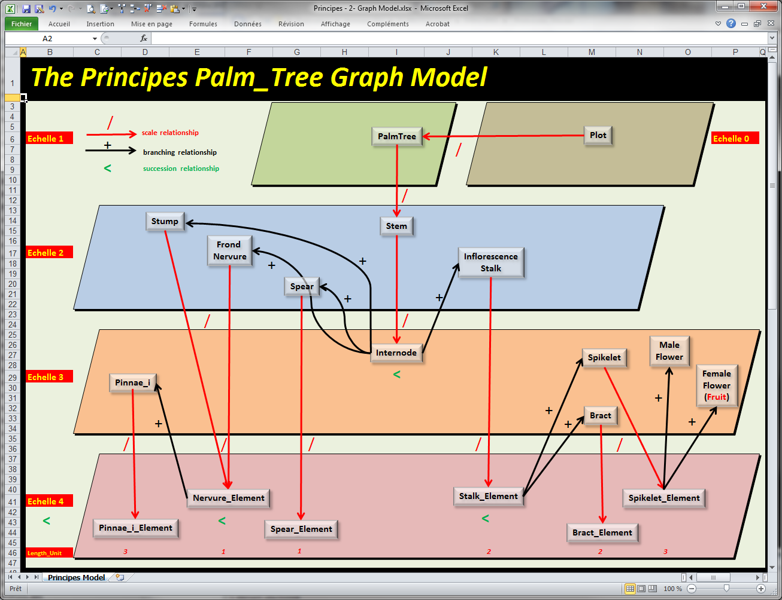

Slide 45
Features
&
Observations

Slide 46
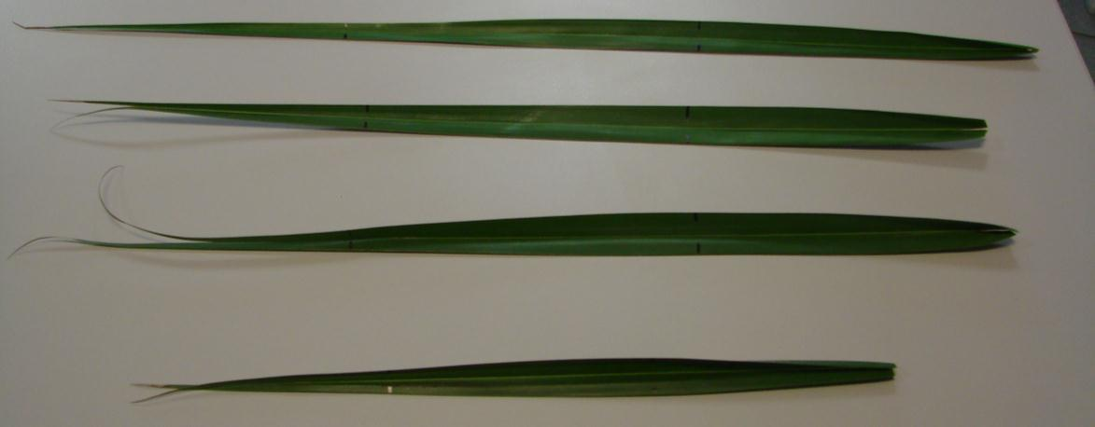
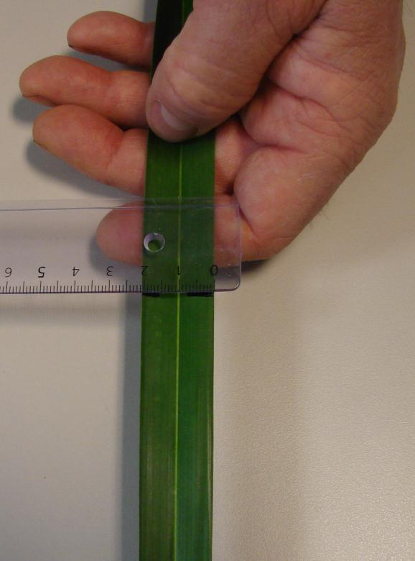
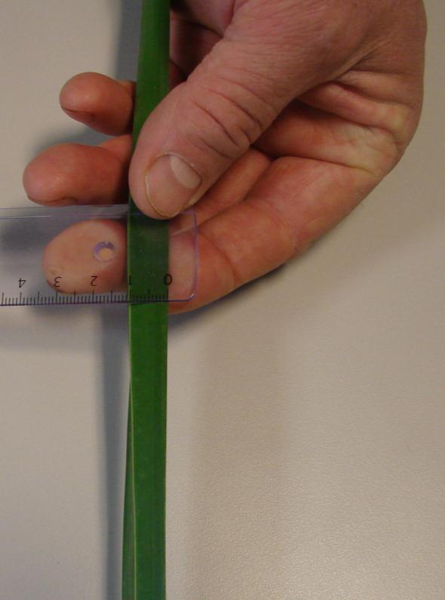
Length
Width
Size
Height
Phoenix dactylifera
46

Slide 47
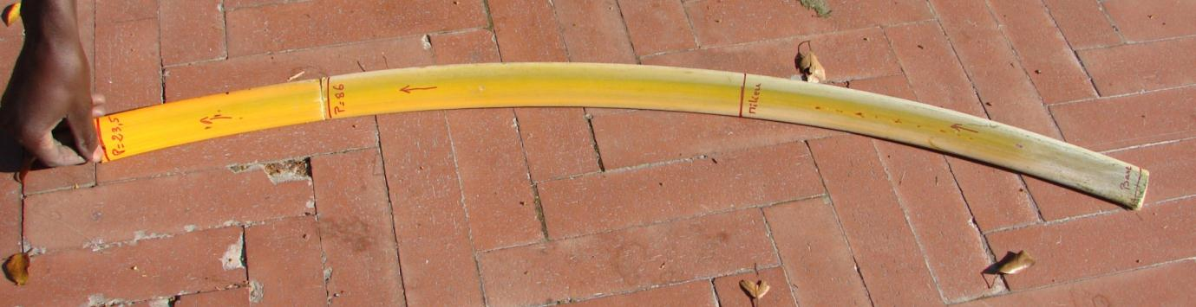
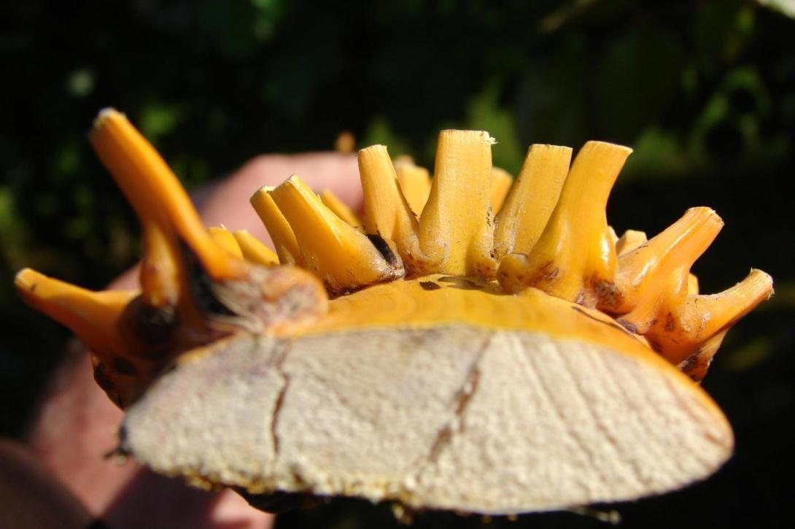
Length
Phoenix dactylifera
Height
Width
Size
47

Slide 48

Basal
Frond
Characteristics
Ventral
Dorsal
Right
Side
Left
Side
Phoenix dactylifera
Apical

Slide 49
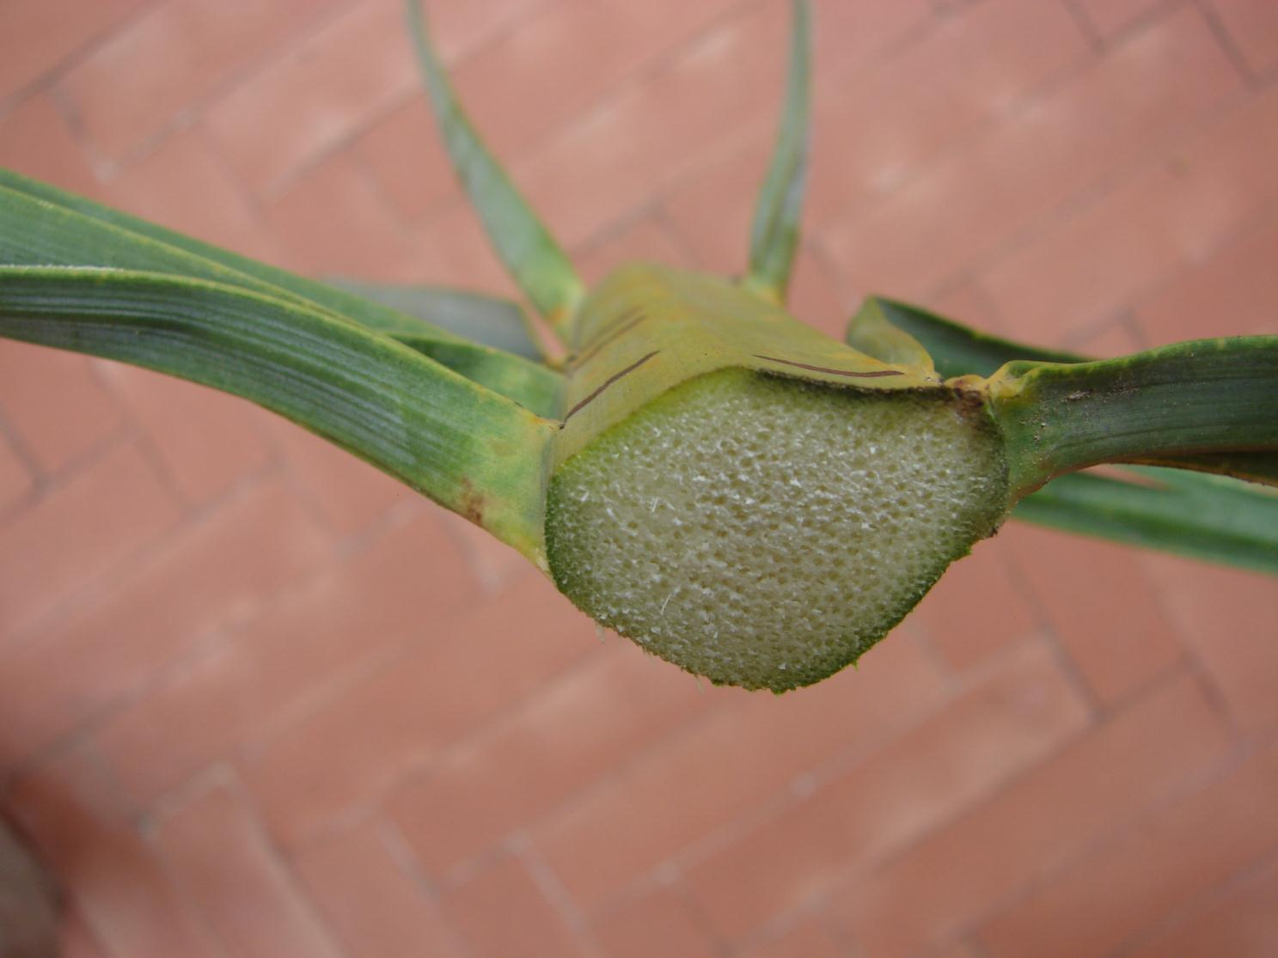
Ventral
Frond
Characteristics
Apical
Basal
Right
Side
Left
Side
Dorsal
Phoenix dactylifera

Slide 50
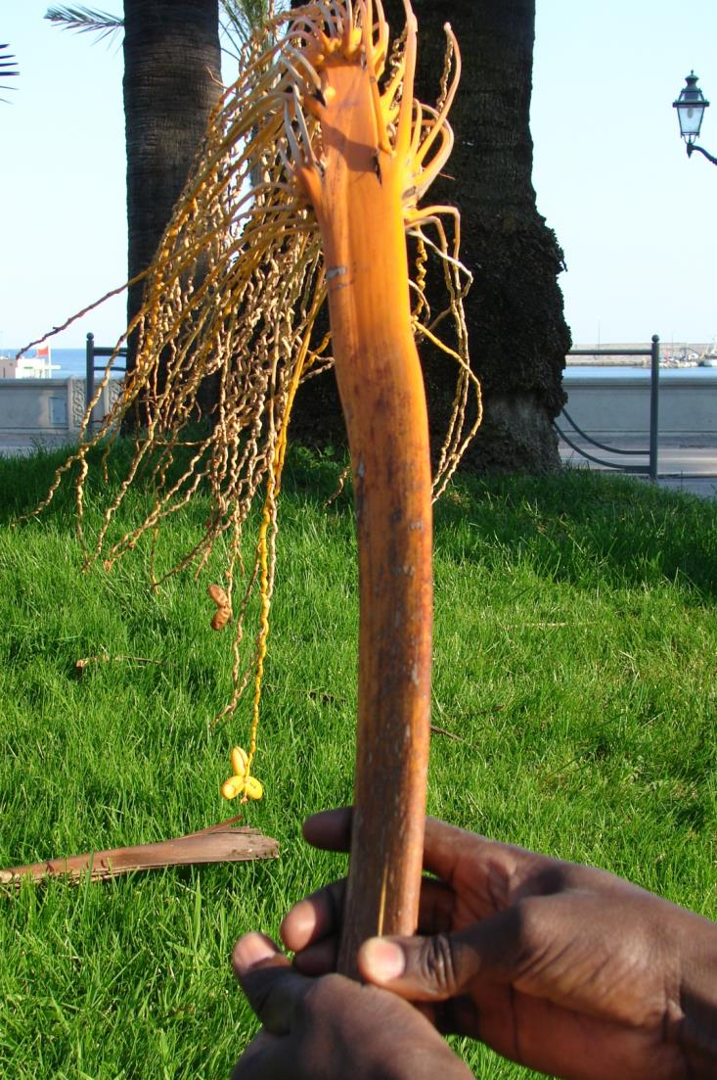
Infrutescence
Characteristics
Apical
Ventral
Left
Side
Right
Side
Dorsal
Basal
Phoenix dactylifera

Slide 51

Infrutescence
Characteristics
Ventral
Apical
Right
Side
Basal
Left
Side
Phoenix dactylifera
Dorsal

Slide 52
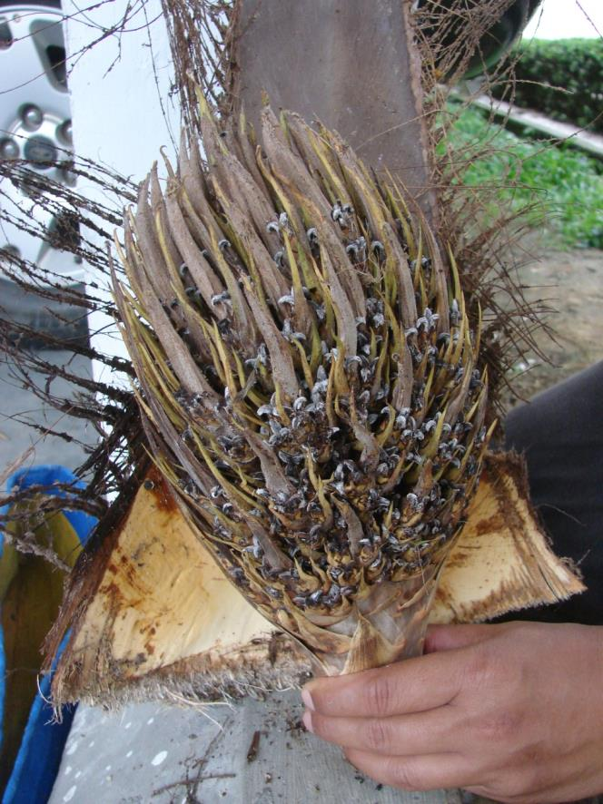
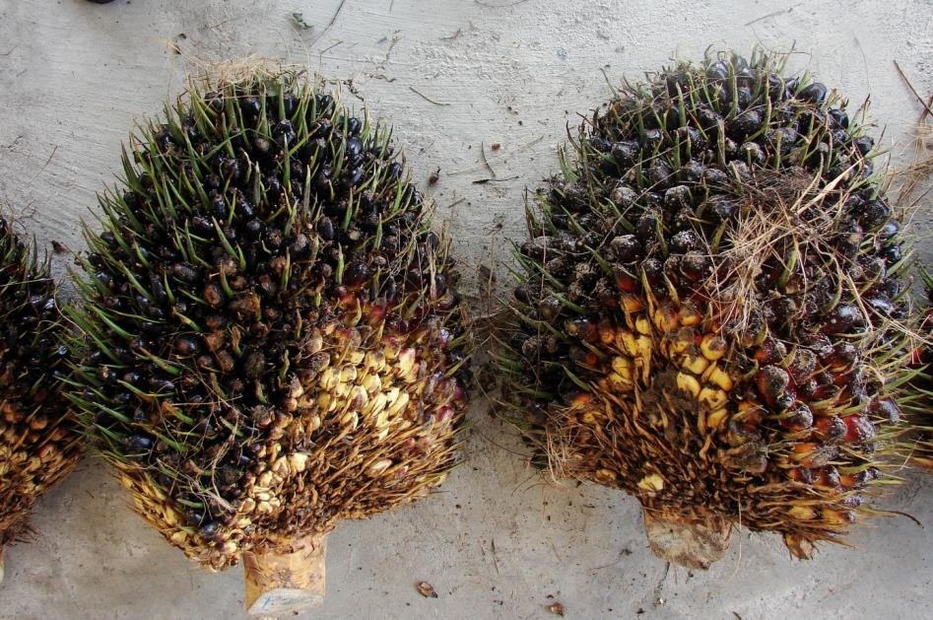
Infrutescence
Characteristics
Ventral
Ventral
Elaeis guineensis

Slide 53
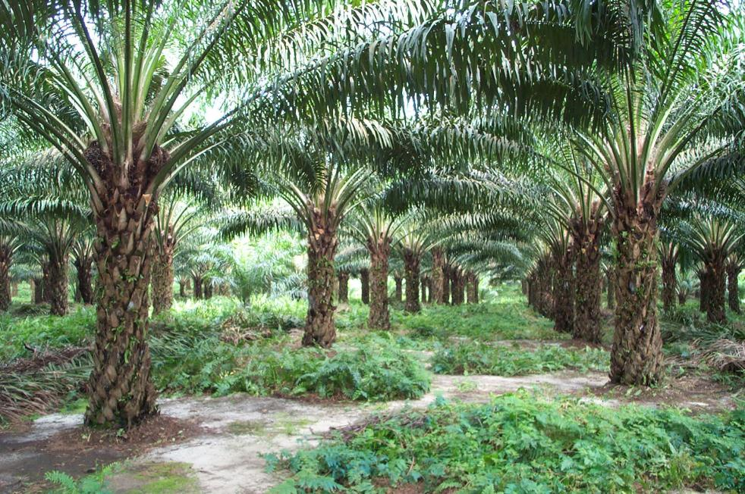
Frond Characteristic Points
« I »
Spine
« C »
Leaflet
« B »
Leaflet
« A »
Rachis
Petiole
Elaeis guineensis

Slide 54
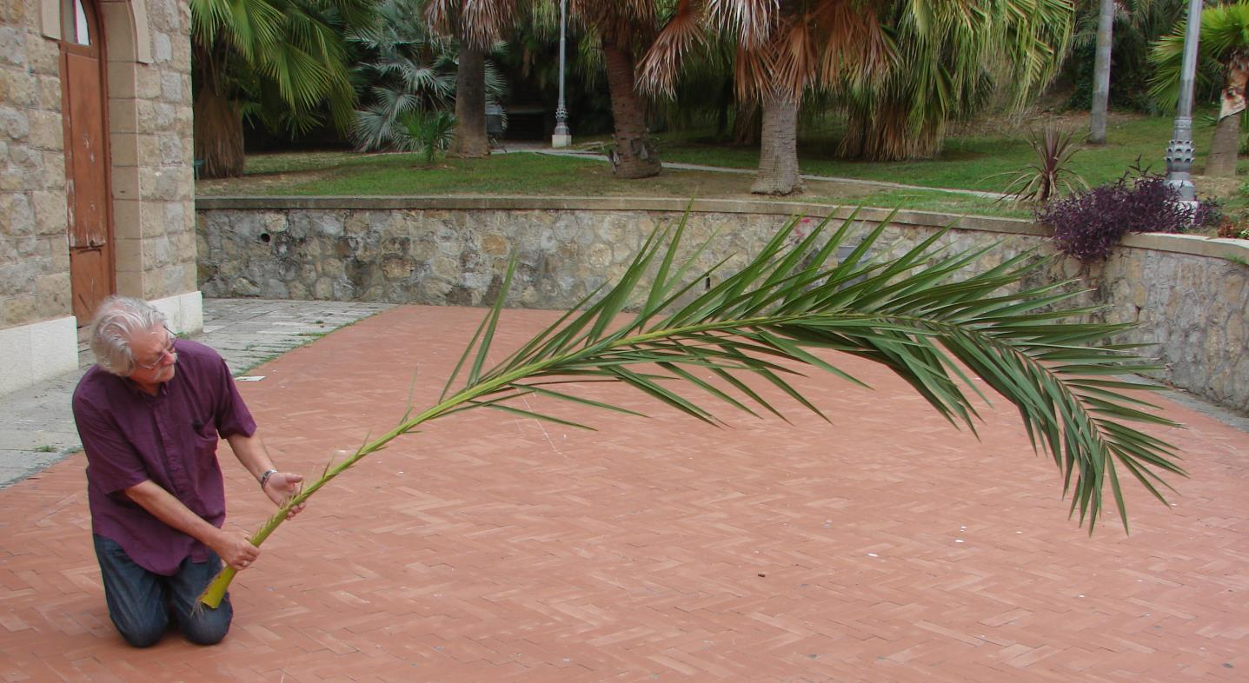
Frond Characteristic Points
« I»
« C »
« ’B’ »
« A »
Thorn
Leaflet
Rachis
Rachis
Petiol
Phoenix dactilifera

Slide 55
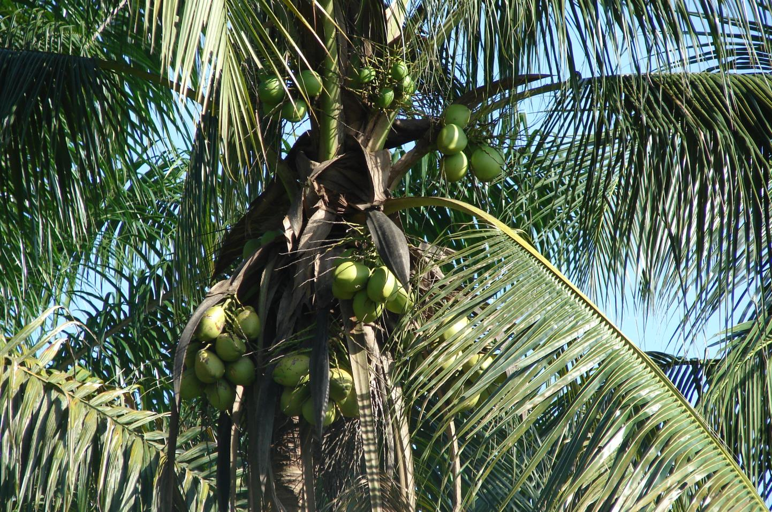
Frond Characteristic Points
Petiole
« C »
Rachis
« B »
Cocos nucifera

Slide 56
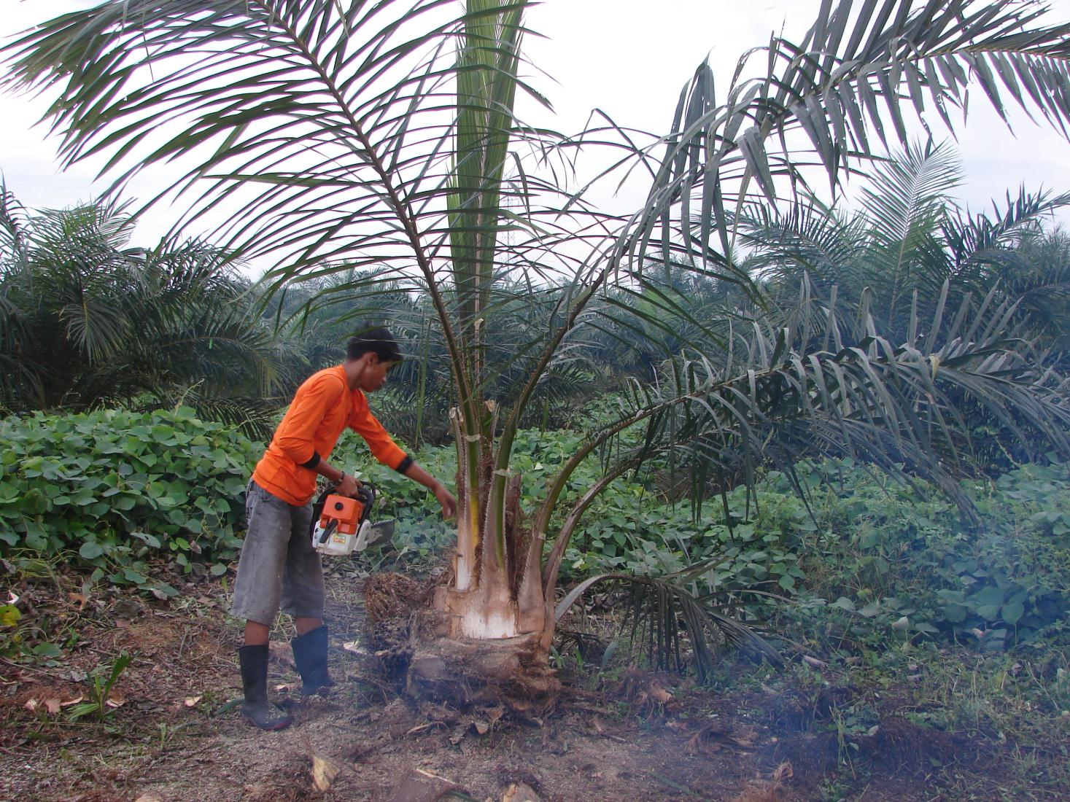
Frond
Characteristic
Points
« I »
Elaeis guineensis

Slide 57
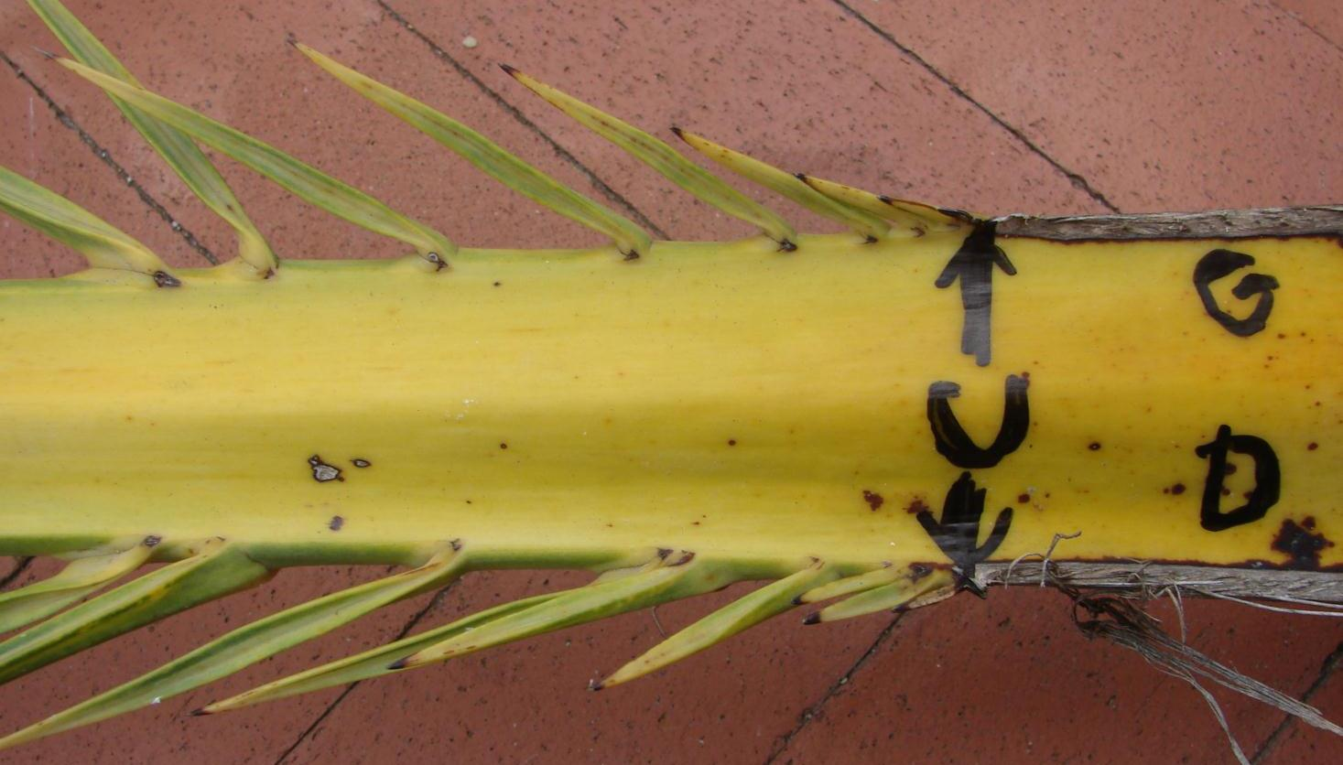
Frond
Characteristic
Points
Pinnae_1
Rachis
Petiole
Phoenix dactylifera

Slide 58
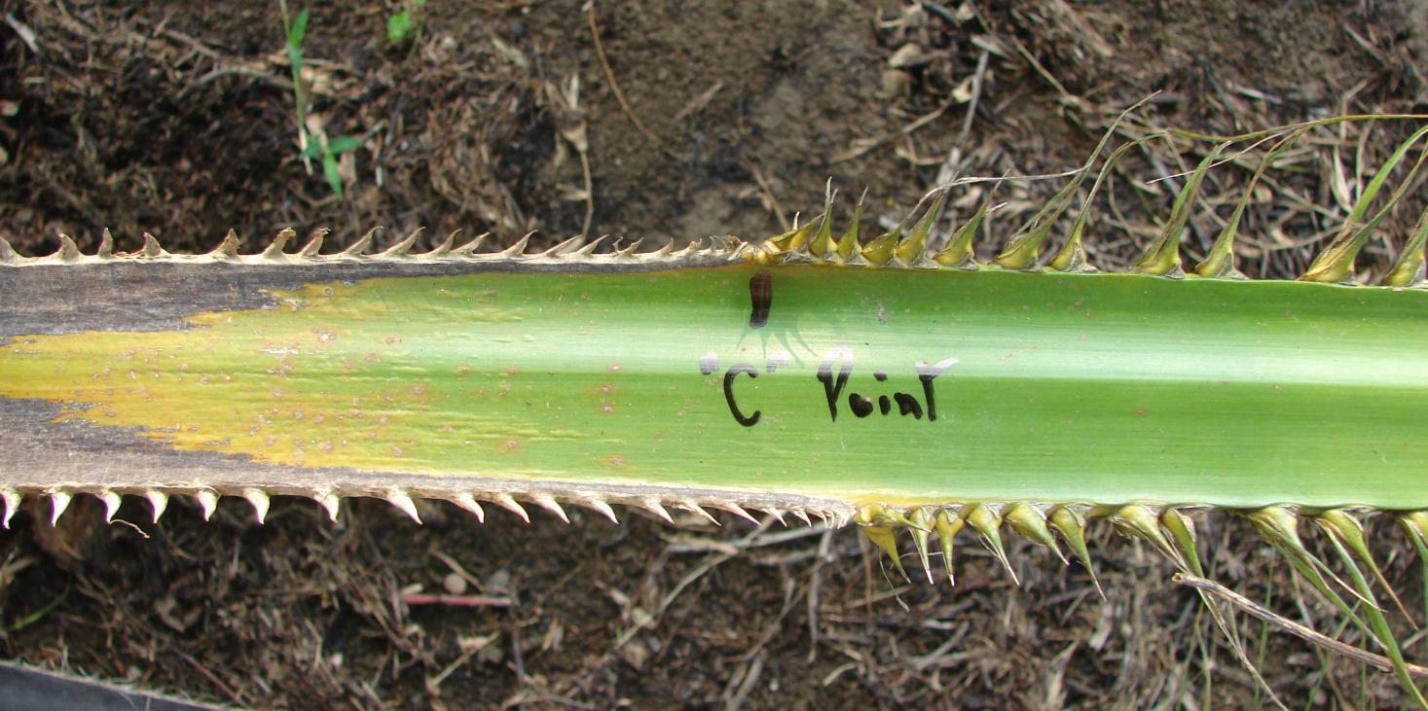
Frond
Characteristic
Points
Thorns
Pinnae_2
Petiole
Rachis
Elaeis guineensis

Slide 59
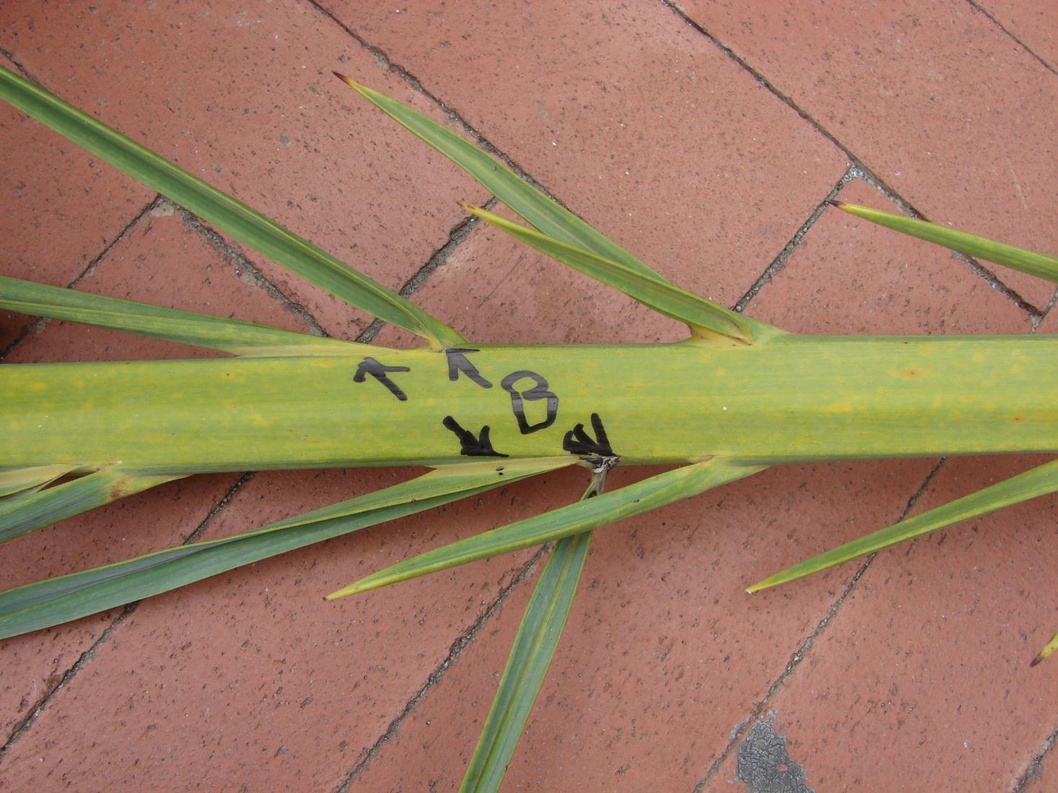
Frond
Characteristic
Points
‘
Transition
Pinnae_1
Pinnae_2
Phoenix dactylifera

Slide 60
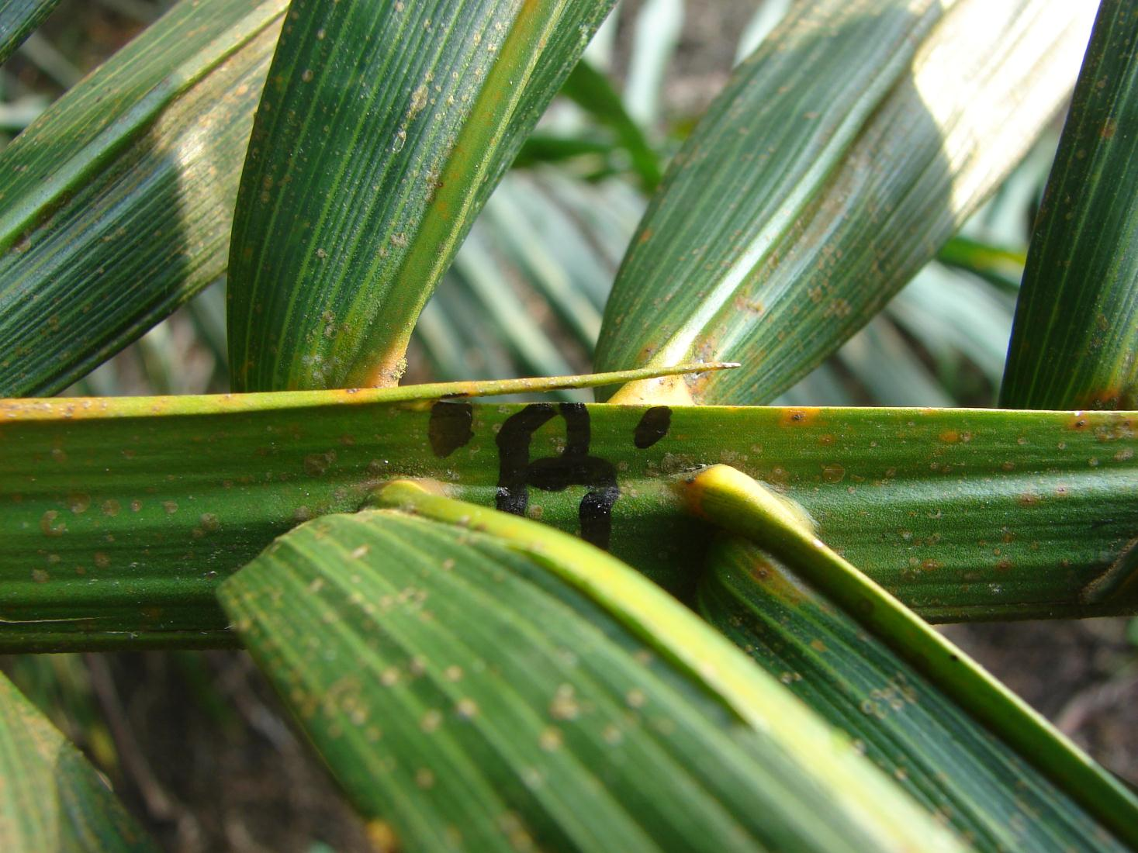
Frond
Characteristic
Points
Frond nervure section evolution
Elaeis guineensis

Slide 61
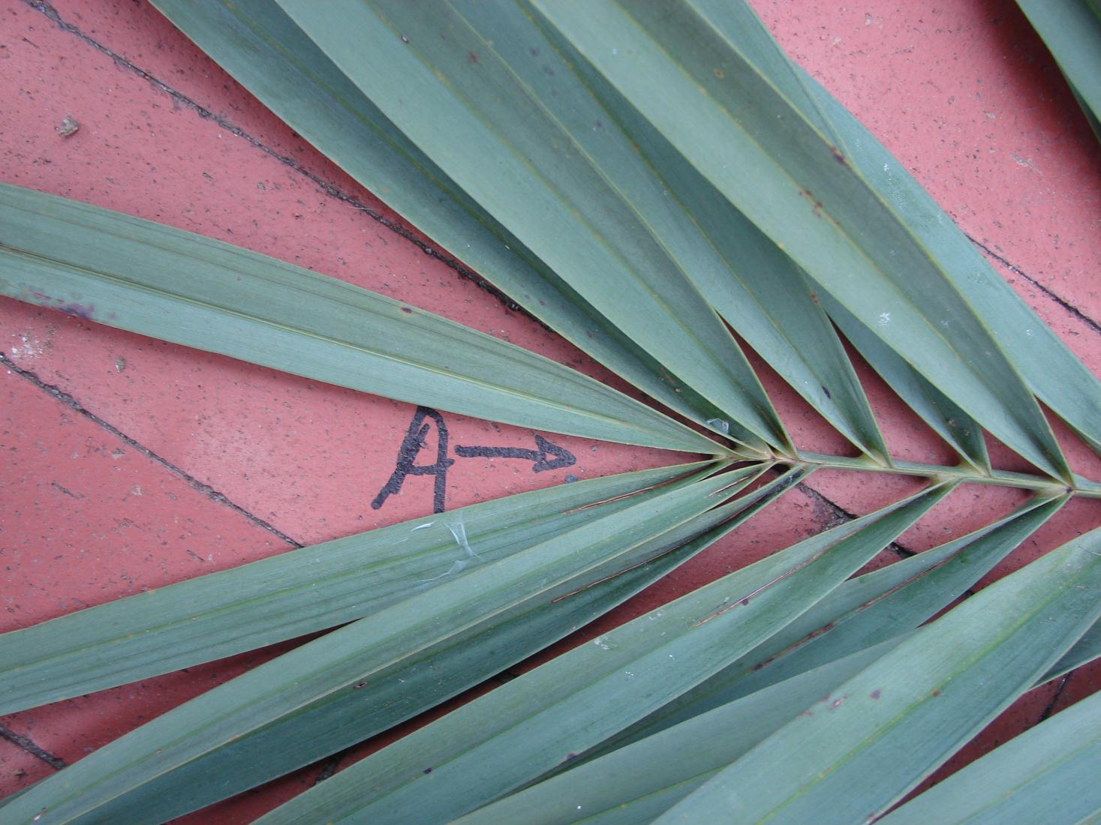
Frond
Characteristic
Points
« A » pical…
Phoenix dactylifera

Slide 62

Frond
Characteristic
Points
« A » pical…
Elaeis guineensis

Slide 63
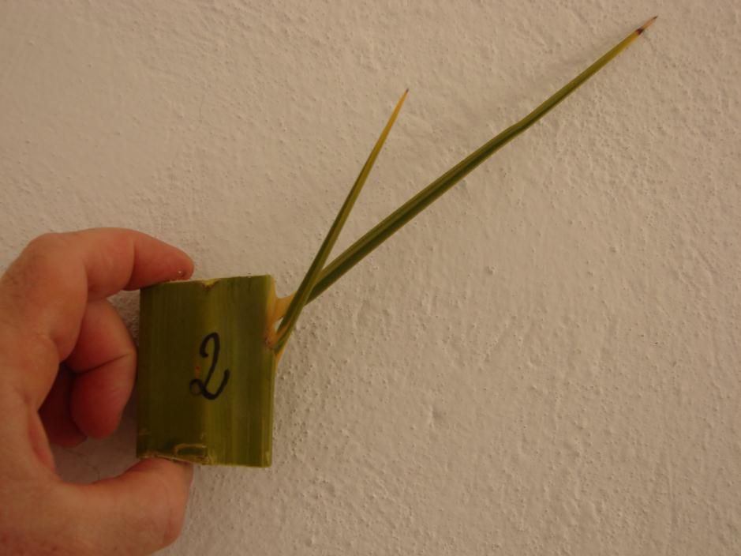

Apical
Axial
Insertion
Angle
Reference
Direction
Axial
Insertion
Angle
Side View
Basal

Slide 64



Radial
Insertion
Angle
Radial
Insertion
Angle
Reference
Direction
Apical View

Slide 65

Pinnae Groups
3
3
2
4
2
2
Phoenix dactylifera

Slide 66


Pinnae Planes
Upper, Middle & Lower Planes
1
1
Phoenix dactylifera
-1
0
Planes
-1
Elaeis guineensis

Slide 67

Pinnae Groups and planes
Groups are in relation
with successions of
« Upper », « Middle »
& « Lower » planes
1 spine or leaflet group
0
2 spines or leaflets group
+1 , -1
3 spines or leaflets group
+1 , 0 , -1
4 spines or leaflets group
+1 , 0 , 0 , -1

Slide 68

Pinnae Insertion Point on frond nervure
Insertion Points on Nervure
Depends upon Pinnae orientation :
Take dorsal side for Phoenix dactylifera
(induplicate)

Slide 69

Pinnae Insertion Point on frond nervure
Insertion Points on Nervure
Depends upon Pinnae orientation :
Take ventral side for Elaeis guineensis and Cocos nucifera
(reduplicate)

Slide 70


Spikelets Pseudo-Verticilles
Phoenix dactylifera

Slide 71

Spikelets Pseudo-Verticilles
Elaeis guineensis

Slide 72


Torsion, Lateral Deviation, Bending Angles
Cocos nucifera
72

Slide 73






Torsion Angle
Radial Vertical Plane
Lateral Deviation Angle
Horizontal plane
Bending Angle
Axial Vertical Plane
73

Slide 74


ZigZag Angle
Phoenix dactylifera
74

Slide 75

Control Points & Parameter values
Parameter values
(ex : leaflet length)
Control Points
According to gradients,
Architectural parameter can take many different values
That are observed at « control points ».

Slide 76
Development
Growth
Topology
Gradients

Slide 77

Assumption : no data model
Observed parameters values
are reproduced through
Piecewise functions
Control points
(X, Y)
Y values are
observed parameters values
X values come from gradients

Slide 78

Gradient types
& parameters
values
X values
Y values
Piecewise functions

Slide 79


Development
Parameters evolve
according to plant development
(phytomer number increase)
Phoenix dactylifera
79

Slide 80


Development
Gradients
are indexed
on position
along stipe
Example : Internode length
1
Phoenix dactylifera
80

Slide 81

Development
Example : Internode length

Slide 82

Growth
Parameters evolve
according to time
(phytomer number increase)
Example : Frond lengthening
Gradients
are indexed
one time
expressed in
phyllochrone
Elaeis guineensis
82

Slide 83

Growth
Example : stipe diameter increase
Phoenix dactylifera
Phoenix dactylifera
83

Slide 84
Growth
Stipe diameter
Example :
Increase

Slide 85

Evolution
Example : Frond axial insertion angle evolution
Phoenix dactylifera
85

Slide 86

Evolution
Frond axial insertion angle
Evolution

Slide 87
Topology
Gradients are indexed
on relative length position of organ
on its bearer
Branching
Example : Pinnae length
Phoenix dactylifera

Slide 88

Topology
Example : Spikelet length
Branching
Phoenix dactylifera
88

Slide 89

Topology
Pinnae
length
Example :
Position
Bearer
Lengthening

Slide 90
Topology
Gradients are indexed
on relative length position
of organ element
Example : Pinnae width
Succession
Pinnae elements
Phoenix dactylifera

Slide 91
Topology
Phoenix dactylifera
Succession
Example : Stalk width
Control points are
relative length position
(% of total length)
of organ itself
91

Slide 92

Topology
Pinnae
width
Example :
Position
Bearer
Position
Element

Slide 93
PRINCIPES
Model
assumptions

Slide 94
main
Development | YES *
Growth | YES *
STRUCTURAL (Topology) | YES
FUNCTIONAL | NO…
* One phyllochrone = One Frond
94

Slide 95
gradients
Development | Parameter values evolve according to frond position along stipe (development).
growth | Parameter values evolve according to organ age (growth).
TOPOLOGY | Parameter values evolve according to organ position.
95

Slide 96
STEM
Parameter dependancy | development | growth | TOPOLOGY
GROWTH DIRECTION | YES
Internode length | YES | YES
Internode diameter | YES | YES
96

Slide 97
Frond nervure
Parameter dependancy | development | Growth | position
LIFE SPAN | YES
RADIAl INSERTION | YES
AXIAL INSERTION | YES | YES
Length Width height | YES | YES | YES
Bending |  | YES | YES
Torsion |  | YES | YES
Lateral deviation |  | YES | YES
97

Slide 98
Pinnaes
Parameter dependancy | development | growth | position
Rotation INSERTION |  |  | YES
RADIAl INSERTION |  |  | YES
AXIAL INSERTION |  | YES | YES
groups |  | YES | YES
Length Width height | YES | YES | YES
STIFFNESS |  | YES | YES
98

Slide 99
INFLORESCENCE Stalk
Parameter dependancy | development | growth | position
LIFE SPAN | YES
RADIAl INSERTION | YES
AXIAL INSERTION | YES | YES
Length Width height | YES | YES | YES
Bending |  | YES | YES
Torsion |  | YES | YES
Lateral deviation |  | YES | YES
99

Slide 100
SPIKELETS
Parameter dependancy | development | growth | position
PSEUDO VERTICILLES |  | YES | YES
RADIAl INSERTION |  |  | YES
AXIAL INSERTION |  | YES | YES
DIVERGENCE |  | YES | YES
Length DIAMETER | YES | YES | YES
STIFFNESS |  | YES | YES
ZIGZAG |  |  | YES
100

Slide 101
FLOWERS & FRUITS
Parameter dependancy | development | growth | position
LIFE SPAN | YES
RADIAl INSERTION |  |  | YES
AXIAL INSERTION |  | YES | YES
groups |  | YES | YES
Length DIAMETER |  | YES | YES
FRUCTIFICATION |  |  | YES
101

Slide 102
Simulation
Visualisation

Slide 103
In AMAPstudio suite
Xplo software
Simeo software
103

Slide 104

Parameter File
104

Slide 105

Parameter File
105

Slide 106

XPlo Browser

Slide 107


XPlo ration

Slide 108


Slide 109

ARECACEAE
Trachycarpus fortunei
Danke
Gracias
Grazie
Hvala
Mersi
Obrigado
Sheshe
Shoukran
Spassiba
Terimah Kasih
Thank you
109

